Slide 1


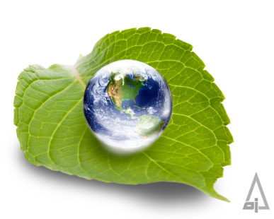


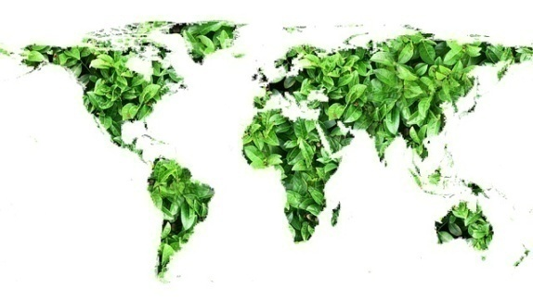
Ecology and
Environment

Slide 2
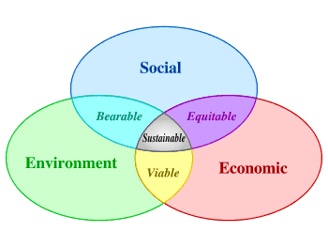
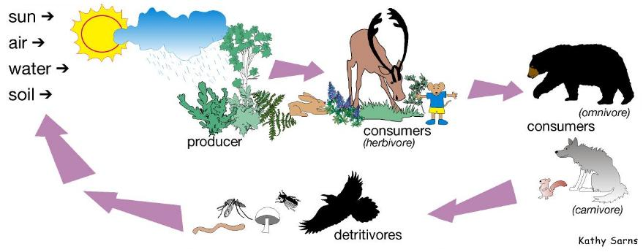
Ecology
Ecology
  Study of the factors that governs the distribution and abundance of organisms in natural environments
  The scientific analysis and study of interactions among organisms and their environment, such as the interactions organisms have with each other and with their abiotic environment
Habitat
Earth’s surface inhabited by life
    Terrestrial
    Aquatic
    Marine
    Freshwater
Food chain
  Sequence of consumption for producers to consumers

Slide 3


What is Climate Change?
Climate is the average weather at a given point and time of year, over a long period (typically 30 years).
We expect the weather to change a lot from day to day, but we expect the climate to remain relatively constant.
If the climate doesn’t remain constant, we call it climate change.
The key question is what is a significant change – and this depends upon the underlying level of climate variability

Slide 4
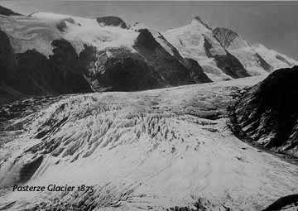
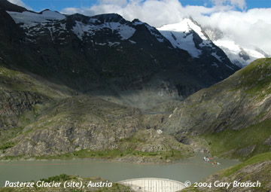
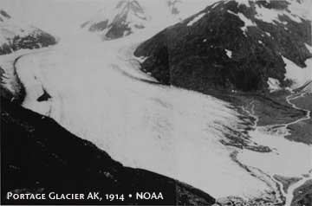
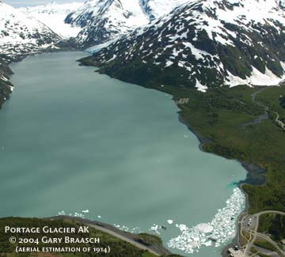
Evidence of Climate Change

Slide 5
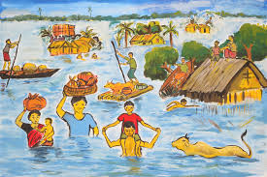
Impact on India
The poor and developing countries of tropical regions are the most vulnerable of the climate change.
Small island countries of Indian Ocean, like, Maldives, Mauritius and Sri Lanka, will migrate to India as climate refugee. (India has made such agreements with these countries)
Indian coastal cities will face danger of submergence.
Erratic Rainfall, melting of Himalayan glaciers, frequent flooding, draughts, storms and cyclones.
Food insecurity for large population.
New diseases and weather patterns.

Slide 6
Global Warming
The gases which trap heat make up less than 1% of the atmosphere! They are called the ‘greenhouse gases’.
The main greenhouse gases are:
Carbon dioxide
Methane
Nitrous oxide
Ozone
Water vapour
The atmosphere is the air around the surface of the earth. It is made from a mixture of gases. We need it for animals and plants to survive.
Some of the gases act like a blanket, trapping heat. These gases are called ‘greenhouse gases’.
This is known as the ‘Natural Greenhouse Effect’. Without it, the earth would be much colder

Slide 7



Natural Greenhouse effect
Enhanced Greenhouse effect
Atmosphere has more greenhouse gases
Heat radiates from the earth
Heat radiates from the earth
Some heat goes out to space
Less heat goes out to space
Atmosphere traps some heat
Atmosphere traps more heat
Quite a lot of heat is trapped and the earth is warm enough for life.
More heat is trapped and causes global warming

Slide 8

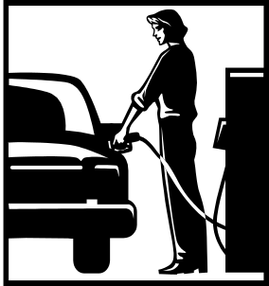
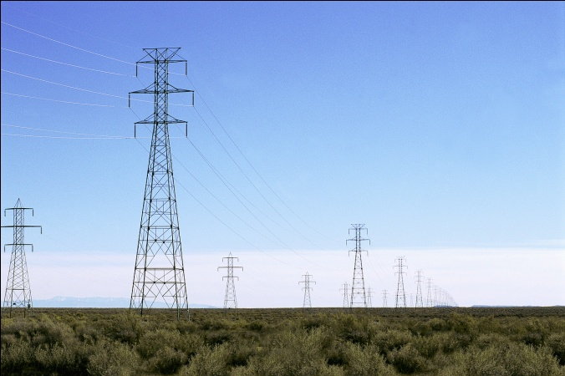


How do humans increase carbon dioxide levels in the atmosphere?
Burning fossil fuels releases the carbon dioxide stored millions of years ago. Most of the increased carbon dioxide comes from fossil fuels
Deforestation releases the carbon stored in trees. Less trees also means less carbon dioxide can be removed from the atmosphere.

Slide 9


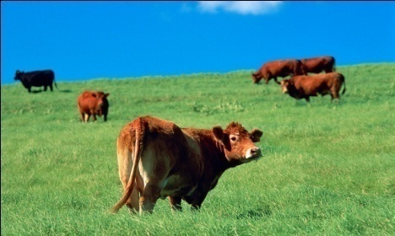
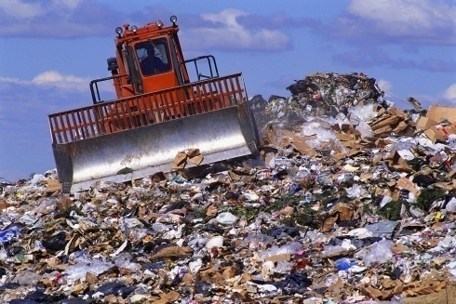


How do humans increase methane levels in the atmosphere?
Methane is produced when bacteria rot organic matter
Increased rice growing
Increased rubbish in landfill
Increased livestock farming
Methane is also released when fossil fuels are extracted
The amount of methane in the atmosphere has increased by two and a half times since the Industrial Revolution.

Slide 10
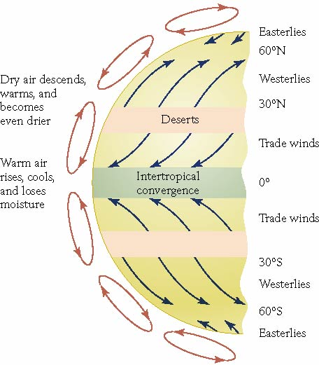
Temperature Variations
Atmosphere retains heat
Solar radiation
  Absorbed and turned into heat energy
  Reflected
    6-10% ocean
    5-30% forest
    45-95% ice and snow

Slide 11
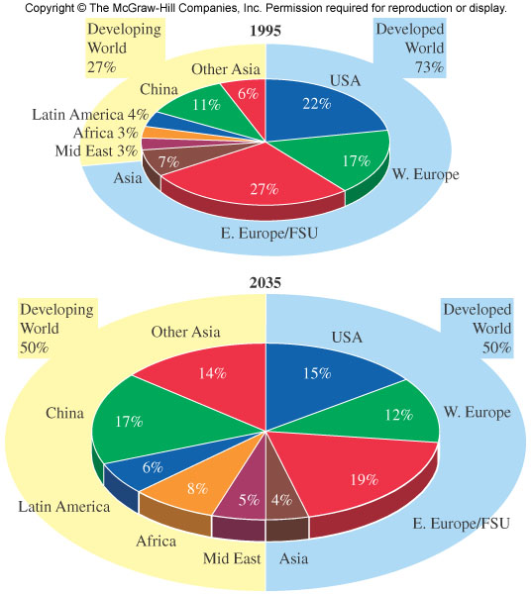
Increasing global CO₂ emissions and changing sources

Slide 12
The Kyoto Protocol - 11 December 1997
.
It is an international treaty, to reduce greenhouse gases emissions, based on the premise that (a) global warming exists and (b) man-madeCO₂ emissions have caused it(currently 192 Parties )
Kyoto protocol wants the Industrialised nations to reduce their green house gas emission by around 5.2% by 2012. (measured against 1990 levels)
Annex means some elaboration/detail given at the end of a treaty
Annex | What?
Annex I | List of industrialized countries and economies in transition: US, France, Japan etc. These countries had pledged to reduce their greenhouse gas emissions to 1990 levels by the year 2000.
Annex II | A sub-group of Annex 1 Countries, these Annex II countries are required to give financial assistance and technology to the developing countries (non-Annex countries).
Non Annex | Developing countries like India, Brazil, China. They donot have compulsory binding targets to reduce green house gas emission, although they are encouraged to do it.
Annex A | It gives the list of 6 Green House gases that are responsible for the whole problem Carbon dioxide (CO2); Methane (CH4); Nitrous oxide (N2O); Hydrofluorocarbons (HFCs); Perfluorocarbons (PFCs); and Sulphur hexafluoride (SF6)
Annex B | This gives the Annex I countries (Developed countries) – compulsory binding targets to reduce green house gas emission. For example USA is required to cut down its emission by 7%

Slide 13
The Kyoto Protocol
In Earth Summit, Rio De Janero, Brazil, they formed a treaty called UNFCCC
The UNFCCC meets every year, on how to fix the global warming problem and these meetings are called Conference of Parties “COP”.
In third such COP meeting @Kyoto, Japan, they come up with an idea under which
  Developed nations like US, will compulsorily reduce their green house gas (GHG) emission by 2012.
  Developing nations like India, should reduce GHG emission but not compulsory.
Although various countries signed Kyoto Protocol in 1997, it did not came into force immediately.
Kyoto protocol came into force only after required number of Annex 1 Countries ratified it.
So this was achieved only in 2005.Thus, Kyoto although signed in 1997, came into force in 2005.

Slide 14
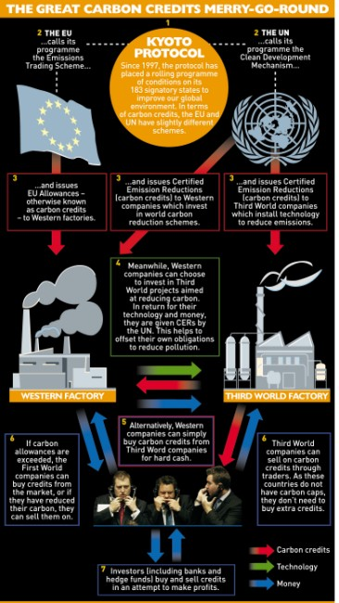
Emissions Trading / Carbon Trading
Suppose two Annex B parties are Japan and Australia.
Japan was given quota of 100 units And Australia quota of 200 units.
But Austrialian Government is unable to maintain this limit and Australia emits 210 units of green house gas, in given year.
On the other side, Japanese Government takes very strong steps to control emission and hence they only emit 90 units of Green House gas. So it has spare 10 Kyoto Units.
Now, under Emission trading system, Australia can buy this 10 spare kyoto units from Japan and thus remain within its limit.
Clean Development Mechanism (CDM)
Suppose Annex B country Australia is given emission quota of 200 units, but it emits 210 units of green house gas.
But Australia can finance a solar power project in some village of India (Non-Annex or developing Country) and get certificate that the solar plant led to reduction of 10 units of green house gas. In this way, Australia will remain in its quota/limit.

Slide 15
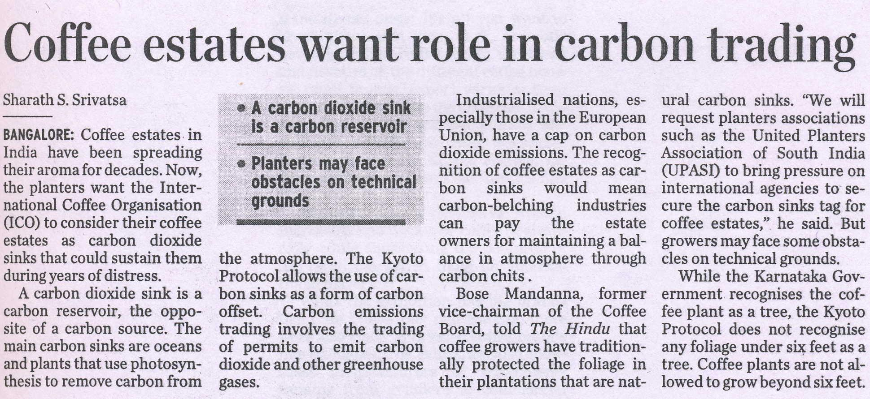
INDIA AND CARBON CREDITS
DMRC has earned the carbon credits by using regenerative braking system in its trains that reduces 30% electricity consumption.
India has the highest number of CDM projects registered and supplies the second highest number of Certified Emission Reduction units. Hence, India is already a strong supplier of Carbon Credits and can improve on it.
Multi Commodity Exchange (MCX), India’s largest commodity exchange, has launched futures trading in carbon credits
IDBI has set up a dedicated Carbon Credit desk, IDBI has entered into formal arrangements with multi-lateral agencies and buyers of carbon credits like IFC, Washington, KfW, Germany and Sumitomo Corporation, Japan and reputed domestic technical experts like MITCON.
.
HDFC Bank will work with the two companies on awareness building, identifying and registering Clean Development Mechanism (CDM) and facilitating the buy or sell of carbon credits in the global market. Bank has signed an agreement with Cantor CO2E India Pvt Ltd and MITCON Consultancy Services Limited (MITCON) for providing carbon credit services.

Slide 16
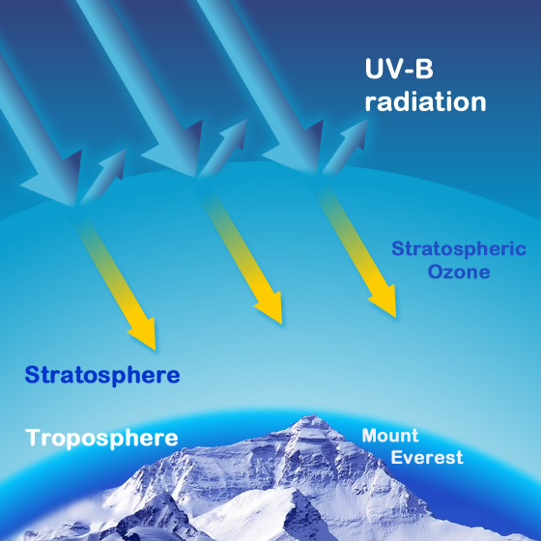
Ozone layer
Ozone gas in stratosphere prevents 99.5% entry of UV radiation on earth
Chlorofluorocarbons(Used in Refrigerators, spray cans, insulation foam and propellant)
Once they’re released in atmosphere, they reach stratosphere=> react with UV=> release Chlorine free radicals => Ozone broken
1980s: Scientists realized Chlorofluorocarbons (CFCs) reach had damaged Ozone layer above Antarctica. Result?
  Skin cancer, Cataract, Sunburns
  Phytoplanktons die=> fish population declines.
  Soil Moisture content declines, plant proteins are mutated=> plant growth affected.
  Fibres and Wall paints fade faster.

Slide 17

Montreal Protocol -September 16, 1987
Entered into force on January 1, 1989, followed by a first meeting in Helsinki, May 1989
2014: CFC has declined by 90%, Ozone layer showing signs of recovery- as per United Nations Environment Program (UNEP) and the World Meteorological Organization (WMO)
This will also prevented 2 million skin cancer cases per year.
2050: Ozone Layer will recover near mid-latitudes
2075: Ozone layer will recover near Antarctic.

Slide 18
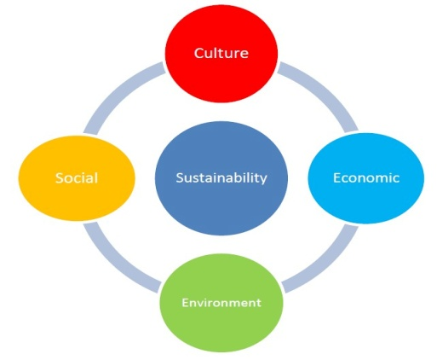
Sustainable Development
“Development which meets the needs of current generations without compromising the ability of future generations to meet their own needs”.
Brundtland commission on World Commission on Environment and Development (1987) gave above definition
Budget 2014 on sustainable Development
12th FYP gave prominent focus to Sustainable development.
Since 90s till now, India has reduced its Carbon dioxide emission by 20% (per unit of GDP)
12% of our energy comes from renewable sources. (23 Gigawatts).
National Action Plan on Climate Change (NAPCC) and State Action Plans on Climate Change (SAPCCs.) have been development

Slide 19
Emission cuts vs India
Between 1850 to 2010: India’s contribution to global emissions was only 2.7%, while that of the USA was 27%
India lacks the resources to effectively respond to sustainability and climate challenges.
We’ve not even achieved basic minimum standards of living for its entire population. 4 crore Indians don’t have electricity in their homes, 8 crore Indians still use firewood for cooking
National Clean Energy Fund (NCEF)
Budget 2014 increased coal cess to Rs.100 per tonne
15k crore rupees spent from this fund on JNNURM Solar lights, wind power projects
But mitigation and adaptation must continue.
We’ve enacted a number of legislations on conservation of forests and ecosystems, waste management, and pollution control.

Slide 20

Climate finance Problems
Developed countries committed to providing US$ 100 billion per year to developing countries by 2020.
But there is no comprehensive system for tracking climate finance ,proliferation of funds, and lack of coordination
Developed countries providing Technological transfer instead of granting money
To reduce global temperature by 2 Degree in 2050, we need 44 trillion USD. No single source will be sufficient for this amount.
Countries can raise more money via domestic resource mobilization (DRM). But that depends on factors such as fiscal performance of the country, natural resource base, and size of tax base etc.
We must explore new funds from South-South cooperation, and private finance.

Slide 21
India’s Action
Solar | Install 20GW solar power by 2022
.Energy | National Mission on Enhanced Energy Efficiency (NMEEE) by 2015, help save about 5% of our annual energy consumption, and nearly 100 million tonnes of carbon dioxide every year
Water | National water mission. increase water use efficiency by 20% focus on over-exploited areas, integrated water Management, awareness generation etc. fancy stuff Finished pilot study on Godavari and Brahmani-Baitarani basin. Water resource ministry got ADB’s technical assistance.
Agro | National mission for sustainable agriculture to enhance agro productivity New activities focusing on horticulture, increases fish production, warehousing and seed processing.
Green India (forest) | National mission for Green India Plant additional 10 million ht. of forest lands, wastelands and community lands.
Habitat | National mission on Sustainable Habitat Energy-efficient buildings, sewage Management, urban planning, transport, etc. six sub sector. 2009: Green Building norms 2013: Energy Conservation Building Code 2007 made mandatory for new as well as old buildings and incorporated in the Central Public Works Department (CPWD)
Knowledge | National mission on Strategic Knowledge for Climate Change Promote knowledge development for health, demography, migration, and livelihood of coastal communities.
Himalayan Ecosystem | National mission for sustaining the Himalayan Eco System To reduce climate impacts on the Himalayan glaciers

Slide 22
America accuses | India defends
Earlier India used to import thin solar films from outside. Nehru Solar mission (phase II), Indian government specifically made guidelines that thin solar films must be procured from desi players violating WTO agreement. | In many states of USA, you’re also doing the same against our solar panels. So, this is tit-for-tat.
As per WTO’s Government Procurement Agreement, you cannot “discriminate” between desi vs foreign players while procuring goods/services for government projects. | But we’ve not signed that stupid agreement!
You’re running a vendetta to hurt American businessmen. | We only want to protect Indian businessmen. In past we’ve even imposed anti-dumping duty on Chinese and Indonesian solar companies.
Our solar panels are of higher quality and cheaper price than your bogus desi products. | Our local industry will never develop, because they won’t make good profits to invest in R&D. We must attain self-reliance for energy security. So even if it means using public money on expensive desi products- that’s fine. Public money should not be used to pay for imports- but to develop domestic production capacity.

Slide 23
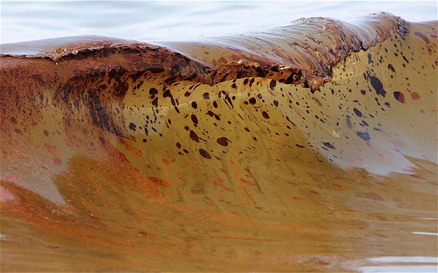
Tar balls
Tar balls are lumps of petroleum
How are they formed? Oil spillage from tankers. Regular ships discharging burnt-oil into sea.
This oil reacts with sea-water=> tar balls formed.
Tar balls were washed ashore during the pre- and post-monsoon period along the Konkan belt Goa, Karwar in Karnataka and south Ratnagiri in Maharashtra.
Why problem? Tar balls harmful for marine organism. They have foul smell, sticky to walk on=beach tourists decline.

Slide 24
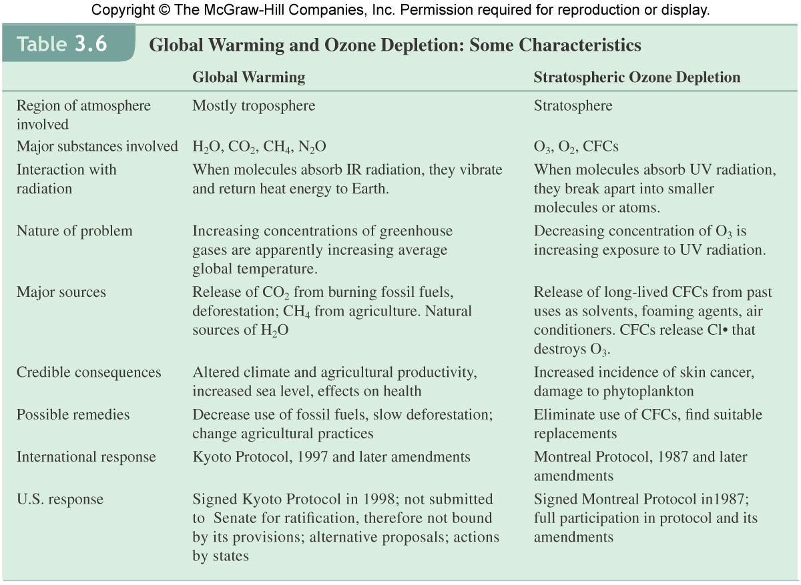

Slide 25

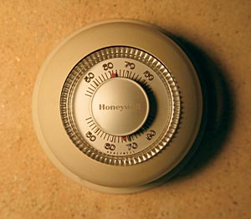

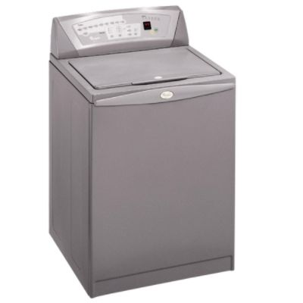

Small changes really add up
Replace your old refrigerator with a new Energy Star:
Annual savings:
700 pounds CO₂
Set your thermostat down a few degrees in the winter
Annual savings:
1400 pounds CO₂
Drive JUST 10 fewer miles per week
Annual savings:
520 pounds CO₂
Reduce your garbage by 10% through greater recycling or reduced packaging
Annual savings:
1200 pounds CO₂
Wash clothes in cold water only
Annual savings:
500 pounds CO₂

Slide 26
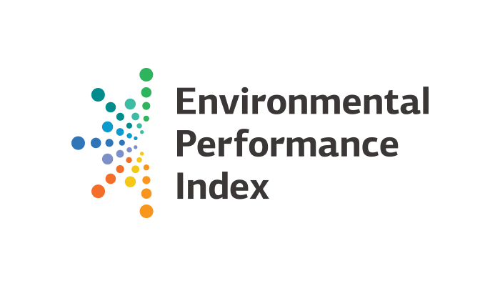

India Index
155/178

